Slide 1



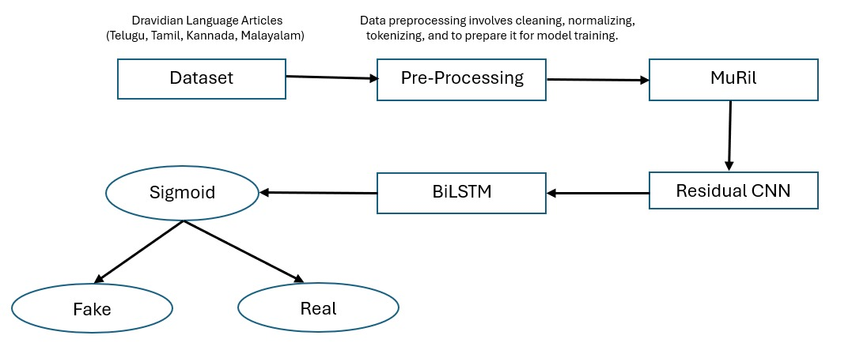
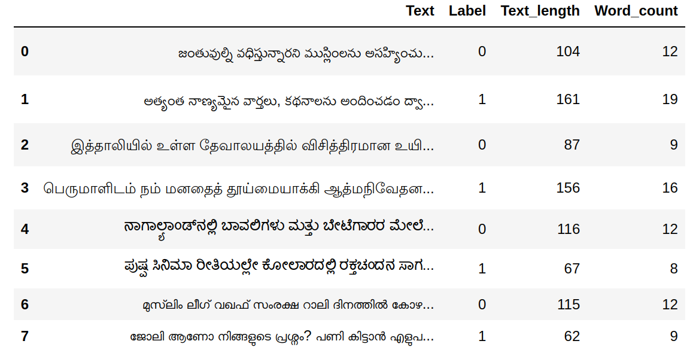
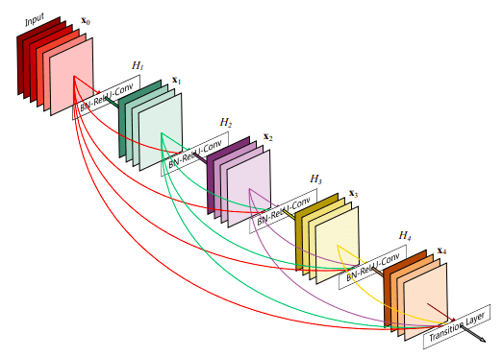
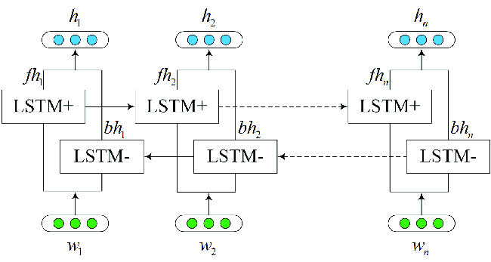
Fake News Detection in Dravidian Languages
Presenter Names
Balaji Kilari-VU21CSEN0101227,Visawanadha Raju-VU21CSEN0100166
Bhavana Indukuri-VU21CSEN0101227, Nallana Riteesh Preetam-VU21CSEN0101555
Guide Name - Dr. Ravi Teja Gedela
Introduction
Data Analysis
"Fake news spreads rapidly, misleading the public and shaping false narratives. While English has robust detection models, Dravidian languages (Tamil, Telugu, Kannada, Malayalam) lack effective solutions due to linguistic complexities and limited resources. This project develops a specialized model to bridge this gap, enhancing misinformation detection and fostering reliable information in Dravidian-speaking communities."
Dravidian_Fake is a new dataset for fake news classification in Dravidian languages.
This dataset contains four Dravidian languages: Telugu, Kannada, Tamil, and Malayalam.
The dataset contains various types of data, like political news, celebrity news, COVID-19 news, sports news, educational news, and business news.
We collected our Dravidian_Fake dataset in IEEE DataPort.(Source Link: Raja, E., Soni, B., & Borgohain, S. K. (2023). DFND: Dravidian_Fake News Data).
Language | Real | Fake | Total
Telugu | 3236 | 3245 | 6481
Kannada | 3058 | 3220 | 6278
Tamil | 3195 | 3082 | 6277
Malayalam | 3098 | 3213 | 6311
Methods
📌 1) MuRiL (Multilingual Representations for Indian Languages)
A pretrained transformer model optimized for low-resource Indian languages like Telugu.
Generates word embeddings to capture contextual meaning.
Converts pre-processed text into a [None, 128, 768] word vector for deep analysis.
2) Residual CNN (ResNet) for Fake News Detection
A Residual Convolutional Neural Network (ResNet) enhances feature extraction through skip connections, allowing information to flow across layers without degradation. This architecture: ✅ Preserves critical local patterns, ensuring short-range dependencies remain intact. ✅ Enhances deep learning models' ability to detect nuanced fake news patterns. ✅ Optimizes information retention, improving accuracy in text classification.
By leveraging ResNet, we strengthen fake news detection in complex linguistic structures. 🚀
.
3) Bidirectional LSTM (BiLSTM) for Contextual Learning
A Bidirectional Long Short-Term Memory (BiLSTM) network enhances sequential data processing by utilizing two LSTM layers—one moving forward and the other backward. This architecture: ✅ Captures contextual insights from both past and future sequences. ✅ Effectively handles long-range dependencies for improved text understanding. ✅ Enhances sequence-based tasks, making it ideal for NLP applications like fake news detection.
4) Sigmoid
Generates probabilities for both fake and real news and outputs from the sigmoid function sum to 1.
The class with the highest probability is chosen as the final prediction
Findings and Results
We experimented with several vanilla pre-trained transformer models such as mBERT, distilBERT, XLM-R, IndicBERT, and MuRiL on the Dravidian_Fake dataset.
From the results, it has been observed that the MuRiL pre-trained model produced superior results compared to others, with accuracies of 92.46% in Telugu, 92.71% in Tamil, 92.39% in Kannada, and 91.78% in Malayalam.
MuRiL model produced superior results, which may be due to the type of data that it has been trained.
Out of all pre-trained models, distilBERT produced poor results. The reason may be that it has not been trained on transliterated data.
Conclusions
Literature review has been carried out. Testing multiple pre-trained models helped us understand their effectiveness on this dataset.
Existing models may not fully address the nuances of Dravidian scripts, suggesting a need for specialized approaches.
The proposed Residual CNN- BiLSTM model on MuRiL embeddings will be implemented next to enhance performance.
References
Raja, E., Soni, B., & Borgohain, S. K. (2023). Fake news detection in Dravidian languages using transfer learning with adaptive finetuning. Engineering Applications of Artificial Intelligence, 126, 106877.
Raja, E., Soni, B., Lalrempuii, C., & Borgohain, S. K. (2024). An adaptive cyclical learning rate based hybrid model for Dravidian fake news detection. Expert Systems with Applications, 241, 122768.
Raja, E., Soni, B., & Borgohain, S. K. (2024). Fake news detection in Dravidian languages using multiscale residual CNN_BiLSTM hybrid model. Expert Systems with Applications, 250, 123967.
Raja, E., Soni, B., & Borgohain, S. K. (2024). Harnessing heterogeneity: A multi-embedding ensemble approach for detecting fake news in Dravidian languages. Computers and Electrical Engineering, 120, 109661.
Raja, E., Soni, B., & Borgohain, S. K. (2022, December). Fake news detection in dravidian languages using transformer models. In International Conference on Computer Vision, High-Performance Computing, Smart Devices, and Networks (pp. 515-523). Singapore: Springer Nature Singapore.
CSE, GST, Visakhapatnam

